Slide 1
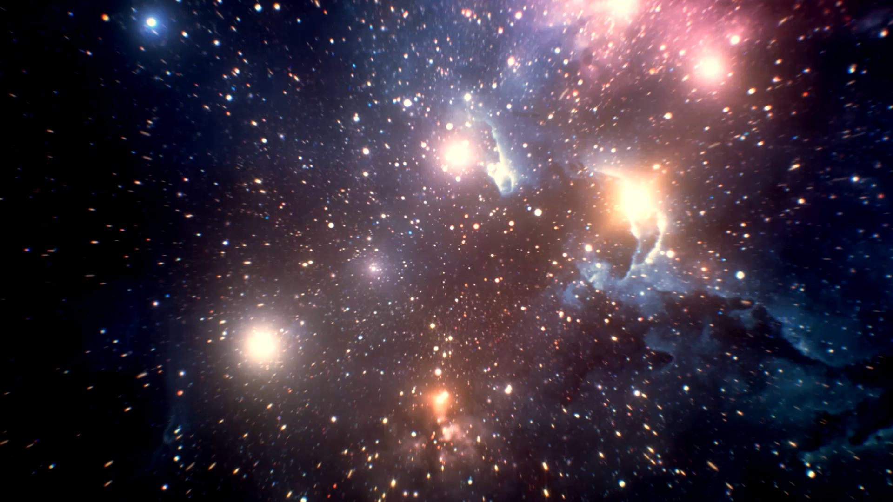
Spacetime
THE UNIVERSE
IS #7

Slide 2
Lecture Recap
What is one thing you remember from the lecture?

Slide 3
Einstein: Speed of light in invariant for all inertial observers

Slide 4

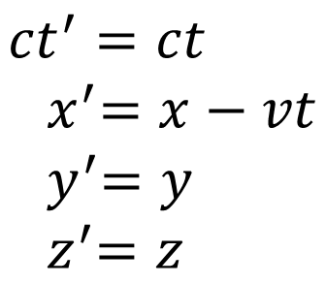
Galilean transformation
Lorentz transformation
$${ct}^{′}=ct \\ { x}^{′}=x−vt \\ { y}^{′}=y \\ { z}^{′}=z$$
$$ct^{′}=γ\left(ct−βx\right) \\ { x}^{′}=γ\left(x−βct\right) \\ { y}^{′}=y \\ { z}^{′}=z$$
Will not result in the invariance of speed of light
Satisfies Einstein’s postulate on the invariance of speed of light

Slide 5

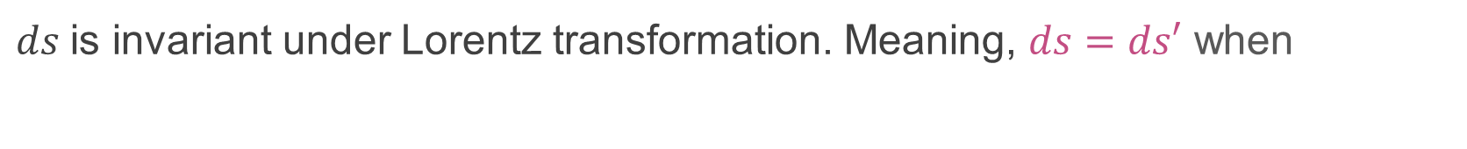
Minkowski: I’ll make Einstein’s theory more nice (and mathy)
Spacetime vector: $\left(ct,x,y,z\right)$
Spacetime interval: $ds^{2}=−c^{2}dt^{2}+dx^{2}+dy^{2}+dz^{2}$
$ds$is invariant under Lorentz transformation. Meaning, $ds=ds′$ when
$$ct^{′}=γ\left(ct−βx\right) \\ { x}^{′}=γ\left(x−βct\right) \\ { y}^{′}=y \\ { z}^{′}=z$$
For something travelling at speed $c$, $ds=0$.
Since $ds′=ds$, $ds′=0$ too! Thing travels at speed $c$ in prime frame too.

Slide 6
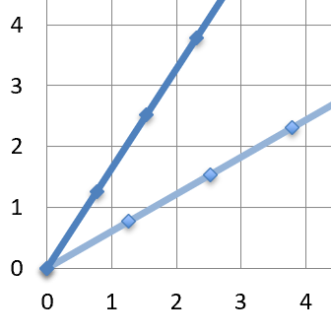
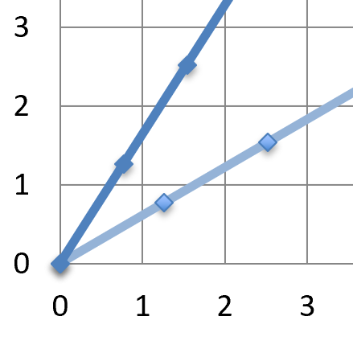




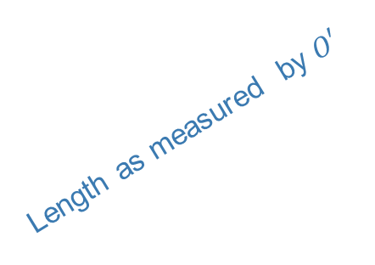

Relativity and Spacetime diagrams are cool stuffs.
$$ct$$
$$ct′$$
$$ct$$
$$ct′$$
Length as measured by $O′$
Length as measured by $O$
Simultaneity is relative
Time (interval) is relative
Length is relative

Slide 7

In-class activities!

Slide 8
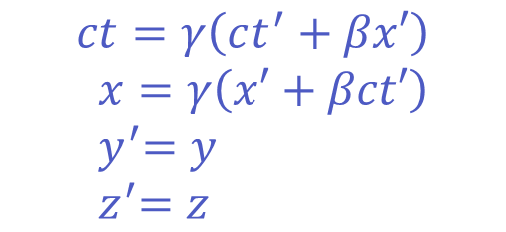
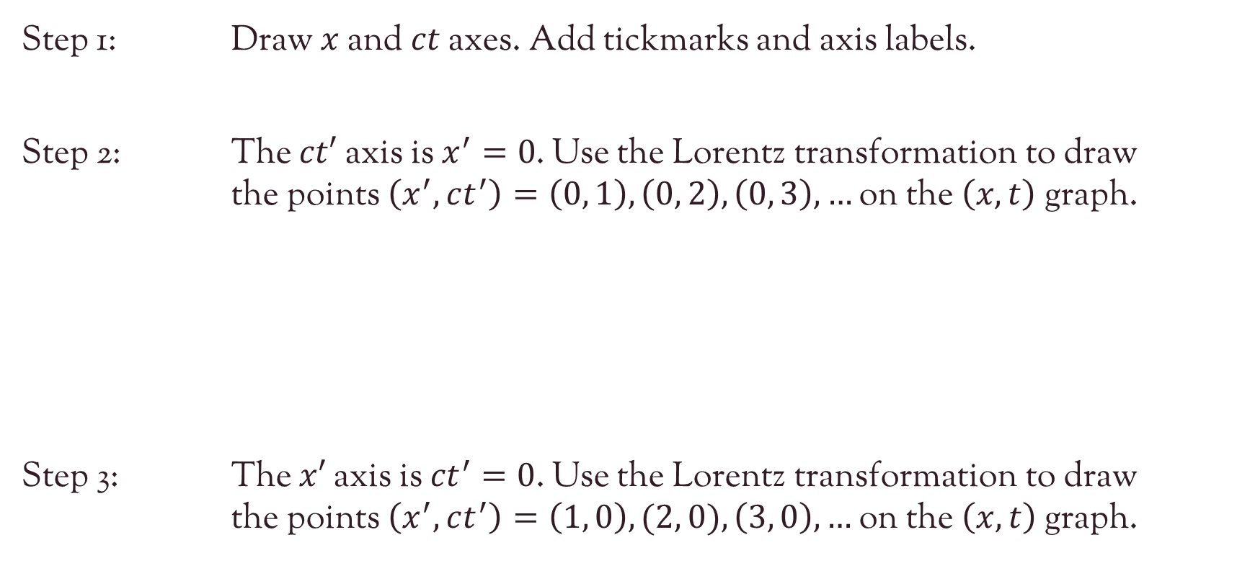
Draw the Spacetime axes for $O$ and $O′$ on a graph paper.
Step 1: Draw $x$ and $ct$ axes. Add tickmarks and axis labels.
Step 2: The $ct′$ axis is $x^{′}=0$. Use the Lorentz transformation to draw the points $\left(x^{′},ct^{′}\right)=\left(0, 1\right), \left(0, 2\right), \left(0, 3\right), …$ on the $\left(x, t\right)$ graph.
Step 3: The $x′$ axis is ${ct}^{′}=0$. Use the Lorentz transformation to draw the points $\left(x^{′},ct^{′}\right)=\left(1, 0\right),(2, 0), \left(3, 0\right), …$ on the $\left(x, t\right)$ graph.
$$ct=γ\left(ct^{′}+βx′\right) \\ x=γ\left(x′+βct′\right) \\ { y}^{′}=y \\ { z}^{′}=z$$

Slide 9

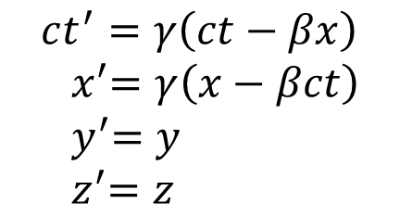


Show that $d{s′}^{2}=ds^{2}$ under Lorentz transformation
$$ct^{′}=γ\left(ct−βx\right) \\ { x}^{′}=γ\left(x−βct\right) \\ { y}^{′}=y \\ { z}^{′}=z$$
Spacetime interval for $O$:
$$ds^{2}=−c^{2}dt^{2}+dx^{2}+dy^{2}+dz^{2}$$
Spacetime interval for $O′$:
$$d{s′}^{2}=−c^{2}d{t′}^{2}+d{x′}^{2}+d{y′}^{2}+d{z′}^{2}$$

Slide 10

Discussion Questions

Slide 11

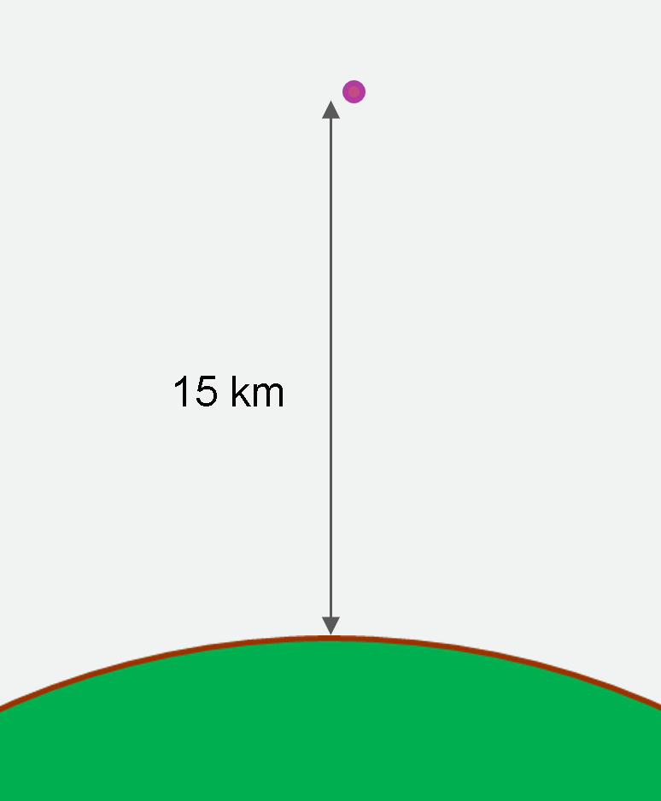



Q2 Worldlines
Q3 Barn and Pole Paradox
Q4 The Muon Paradox

Slide 12
Q2. Worldline trajectories
Worldline of an observer moving with constant speed
Worldline of stationary observer
Worldline of a photon
Worldline of an observer moving with non-constant speed (acceleration)
45º
Acceleration = Curve in spacetime diagram

Slide 13
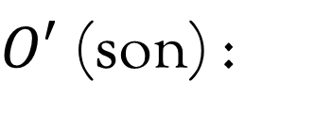
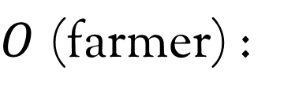


Q3. The barn and pole paradox
$$ct$$
$$ct′$$
Barn
Pole
back
front
back
front
$O$ (farmer) :
then
$O′$ (son) :
then

Slide 14


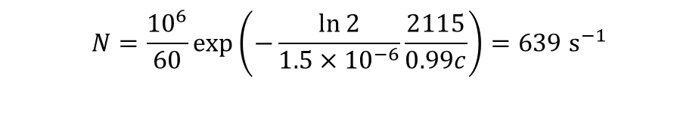



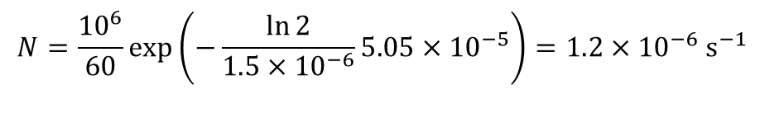



Q4. Life-time of a muon
Half life: $1.5 μs$
(a) Rate of detection without relativistic consideration
Time taken $=15000/0.99c$ $=5.05×{10}^{−5}s=50.5μs$
Rate of production: ${10}^{6}min^{−1}$
$$\frac{N_{0}}{2}=N_{0}e^{−k1.5×{10}^{−6}}$$
$$k=\frac{\ln{2}}{1.5×{10}^{−6}}$$
Speed: $0.99 c$
$$N=N_{0}e^{−kt}$$
$$N=\frac{{10}^{6}}{60}\exp\left(−\frac{\ln{2}}{1.5×{10}^{−6}}5.05×{10}^{−5}\right)=1.2×{10}^{−6} s^{−1}$$
(b) Muon sees a contracted length
15 km
$$L=\frac{1}{γ}15000=\sqrt{1−{0.99}^{2}}15000=2116m$$
(c) Rate of detection with relativistic consideration
$$N=\frac{{10}^{6}}{60}\exp\left(−\frac{\ln{2}}{1.5×{10}^{−6}}\frac{2115}{0.99c}\right)=639 s^{−1}$$

